Slide 1
CEN 3078 Computer Security
Module 1 – Application and Network Analysis

Slide 2
Network and application layers – security concepts
Packet sniffing and spoofing
Intrusion detection systems
Legal and ethical issues
Module 1

Slide 3
Network and application layers – security concepts
Packet sniffing and spoofing
Intrusion detection systems
Legal and ethical issues
Module 1

Slide 4
Module-1: Discussion Topics
Network and application layers – security concepts
Networking and Computing Today
CIA Triad
Standard Definitions
Passive and Active Attacks
Attack Surfaces and Attack Trees
Threat Modeling
Fundamental Security Design Principles
Application Case Studies: Manufacturing, Special Education
Packet sniffing and spoofing
Intrusion detection systems
Legal and ethical issues

Slide 5
Model of Internet Layers for User/Device Communications

Slide 6
TCP/IP Communication

Slide 7
TCP/IP Communication (2)

Slide 8
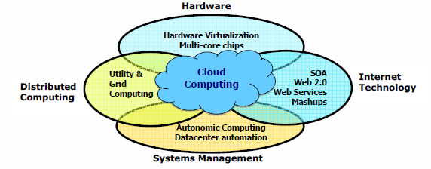
Diverse Computing and Data Deluge Enabling New Cybersecurity Challenges

Slide 9
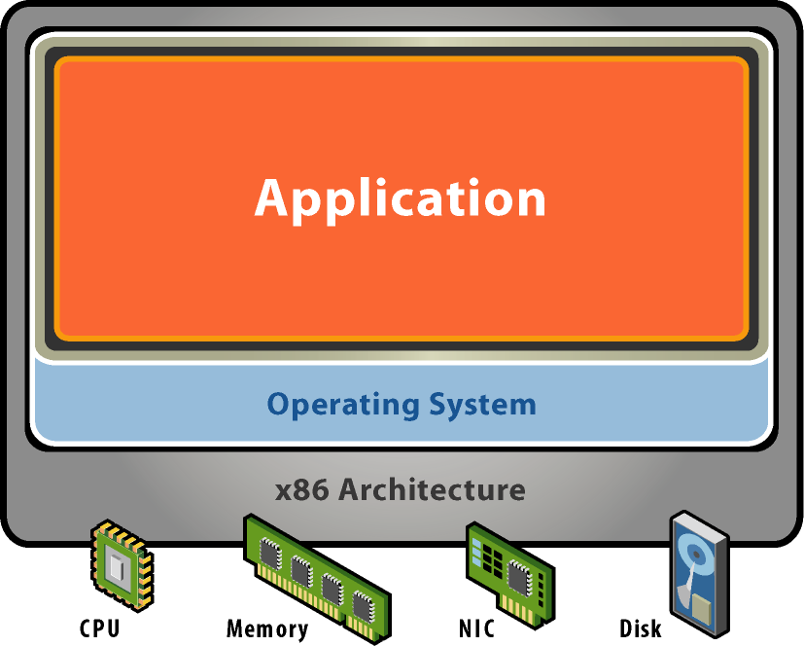
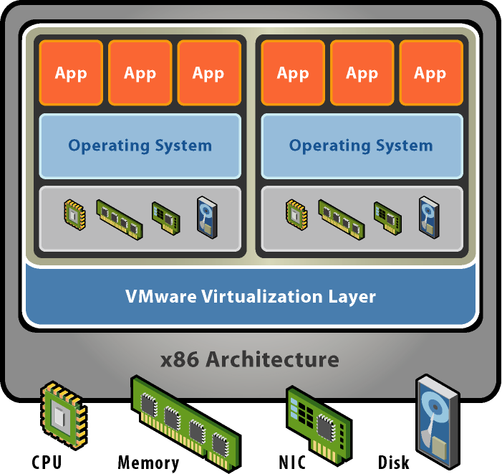
Virtual Machines in Today’s Computing
Without Virtualization
With Virtualization
Notes:
Hardware-independence of operating system and applications
VMs can be provisioned to any system
Can manage OS and application as a single unit by encapsulating them into VMs
Virtual machines are not a new concept. They were developed over thirty years ago for mainframe systems to allow multiple users to safely share those expensive machines. As computers became cheaper, the motivation behind virtualization faded and processor architectures like the Intel x86 were developed without some of the features needed to support virtualization.
VMware’s founders resurrected the virtual machine concept when problems like server proliferation and the need to run multiple applications in dedicated operating systems started becoming serious issues for IT managers and software developers. VMware developed revolutionary technology to efficiently virtualize x86 systems that,for the first time, allowed unmodified x86 operating systems and applications to run in true virtual machines with excellent performance.
Multiple virtual machines can operate concurrently on a single x86 host system. Each one can run a different operating system and application stack.
VMware’s virtualization technology provides each virtual machine with a true representation of an x86 computer, complete with processor, memory, networking interfaces and storage devices. The VMware virtualization layer gives the virtual machines direct access to the underlying x86 hardware – an important distinction from the much slower emulation technology that must process all virtual machine operations in software.

Slide 10
Identifying Types of Threats
Malware: MALicious softWARE
Security breaches
DoS: Denial of Service attacks
Web attacks
Session hijacking
Insider threats
DNS poisoning
New attacks: Doxing

Slide 11
Malware
Software with a malicious purpose
Viruses
Trojan horses
Spyware
Logic bombs

Slide 12
Malware (cont.)
Viruses
One of the two most common types of malware
Designed to replicate and spread
Usually spreads through email
Uses system resources, causing network slowdowns or stoppage

Slide 13
Malware (cont.)
Trojan Horses
The other most common type of malware
Named after the wooden horse of ancient history
Appears benign but secretly downloads malware onto a computer from within

Slide 14
Malware (cont.)
Spyware
A rapidly growing type of malware
Cookies
Key loggers
Logic Bombs
Lay dormant until some logical condition is met, often a specific date

Slide 15
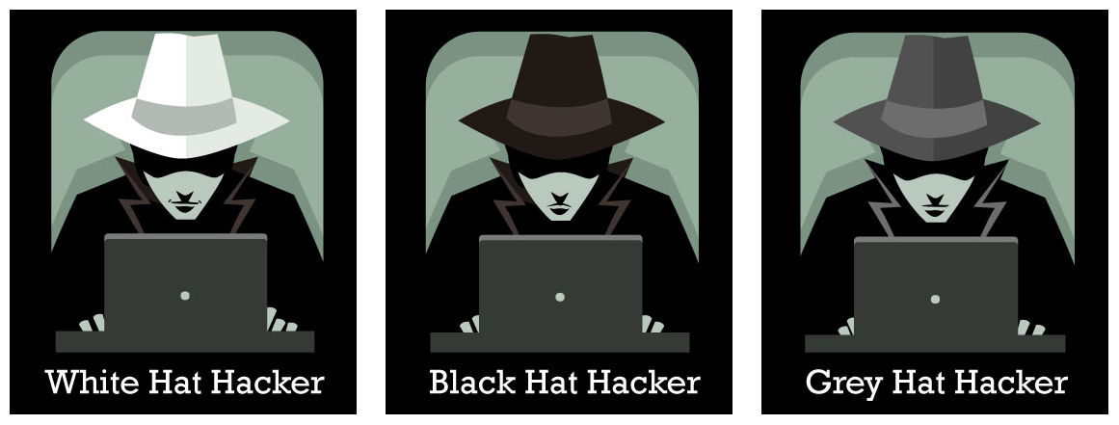
Types of Ethical Hackers
White Hat Hacker
Do not intend to harm the system or organization but they so, officially to penetrate and locate the vulnerabilities, providing to fix them and ensure safety
Black Hat Hacker
They are non-ethical hackers performing hacking to fulfill their selfish intentions to collect monetary benefits
Grey Hat Hacker
Combination of white and black – they hack without any malicious intent for fun; don’t use approval from a targeted organization and publicly disclose any vulnerability

Slide 16
Basic Security Terminology
Devices:
Firewall
Filters network traffic
Proxy server
Disguises IP address of internal host
Intrusion Detection System (IDS)
Monitors traffic, looking for attempted attacks
Activities:
Authentication
Auditing

Slide 17
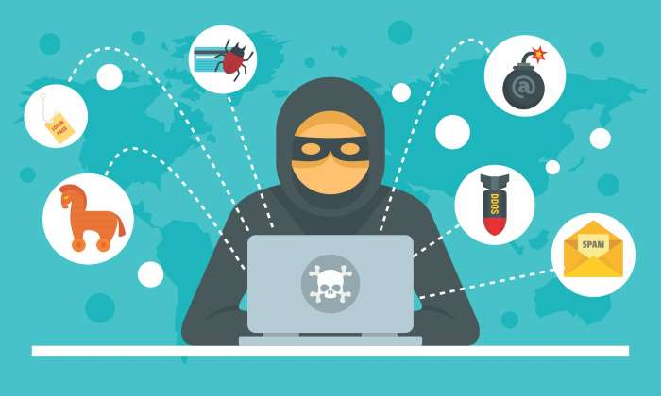
Exercise: Act during an Intrusion
Suppose you observe that your PC is responding very slowly to information requests from the net. And then you further observe that your network gateway shows high levels of network activity, even though you have closed your e-mail client, Web browser, and other programs that access the net.
What types of malware could cause these symptoms?
How might the malware have gained access to your system?
What steps can you take to check whether this has occurred?
If you do identify malware on your PC, how can you restore it to safe operation?

Slide 18
In-Class Exercise: Act during an Intrusion
What types of malware could cause these symptoms?
Virus, Worm
How might the malware have gained access to your system?
Phishing attacks using malicious email messages that activate the virus or worms by using a web link pointing to a malware download or carrying malicious attachments
What steps can you take to check whether this has occurred?
Refer to your anti-virus software logs
Use a traffic network analyzer, like Wireshark, and scan the network traffic for a period of time to possibly determine the type of traffic being generated by the PC, the destination, and also the service that is generating that traffic

Slide 19
In-Class Exercise: Act during an Intrusion
d) If you do identify malware on your PC, how can you restore it to safe operation?
Isolate the machine from any network connections
Attempt to create a backup of the data, although the backup will contain infected files, at least data will be saved for future cleaning
If possible, completely rebuild the system and recover the data from the most recent backup that is considered free from malware
If no backups are available then try to clean the system using an anti-virus package or other data recovery tools
Moral: Have a plan and know your Risks; Consider Cyber Insurance purchase and follow Incident Response best practices…

Slide 20
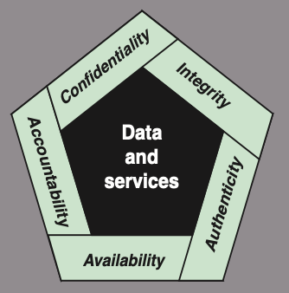
Cyber Security Definition
NIST 7298 Report defines the term cybersecurity as follows:
“Measures and controls that ensure confidentiality, integrity, and availability of information system assets including hardware, software, firmware, and information being processed, stored, and communicated.”
1. What assets do we need to protect?
2. How are those assets threatened?
3. What can we do to counter those threats?
NIST standard FIPS 199 (Standards for Security Categorization of Federal Information and Information Systems)

Slide 21
Key Security Concepts
Confidentiality
Integrity
Availability
Preserving authorized restrictions on information access and disclosure, including means for protecting personal privacy and proprietary information
Loss of confidentiality is the unauthorized disclosure of
information
Guarding against improper information modification or destruction, including ensuring information nonrepudiation and authenticity
Loss of integrity is the unauthorized modification or destruction of information
Ensuring timely and reliable access to and use of information
Loss of availability is the disruption of access to or use of information or an information system

Slide 22
Related CIA Triad Definitions – from Information Assurance Perspective
Confidentiality: This term covers two related concepts:
Data confidentiality: Assures that private or confidential information is not made available or disclosed to unauthorized individuals
Privacy: Assures that individuals control or influence what information related to them may be collected and stored and by whom and to whom that information may be disclosed
Integrity: This term covers two related concepts:
Data integrity: Assures that information and programs are changed only in a specified and authorized manner
System integrity: Assures that a system performs its intended function in an unimpaired manner, free from deliberate or inadvertent unauthorized manipulation of the system
Availability: Assures that systems work promptly and service is not denied to authorized users
Notes:
CREATE A STORY OF A PERSON WHOSE EMAIL IS HACKED, THEN TWITTER IS HACKED WITH REPULSIVE MESSAGES, FACEBOOK FRIENDS BLOCKED, AND THEN BANK INFO IS CHANGED AND THEN EMAIL ACCESS IS DENIED – WRITE ALL DEFINITIONS ON BOARD AND STRIKE OUT TERMS E.G., ADVERSARY, THREAT, ATTACK, ETC.

Slide 23
Application Security vs. Network Security
Application Security
Preservation of confidentiality, integrity, and availability of application information
Other properties such as authenticity, accountability, non-repudiation, and reliability can also be involved
Network Security
Protection of networks and their services from unauthorized modification, destruction, or disclosure
Provision of assurance that the network performs its critical function correctly and that there are no harmful side effects

Slide 24
Other Essential Definitions
Authenticity: The property of being genuine and being able to be verified and trusted; confidence in the validity of a transmission, a message, or message originator
This means verifying that users are who they say they are and that each input arriving at the system came from a trusted source
Non-Repudiation: Assurance that the sender of information is provided with proof of delivery and the recipient is provided with proof of the sender’s identity, so neither can later deny having processed the information (e.g., digital signatures that help one to not deny validity)
Accountability: The security goal that generates the requirement for actions of an entity to be traced uniquely to that entity
This supports non-repudiation, deterrence, fault isolation, intrusion detection and prevention, and after-action recovery and legal action
Because truly secure systems are not yet an achievable goal, we must be able to trace a security breach to a responsible party
Systems must keep records of their activities to permit later forensic analysis to trace security breaches or to aid in transaction disputes

Slide 25
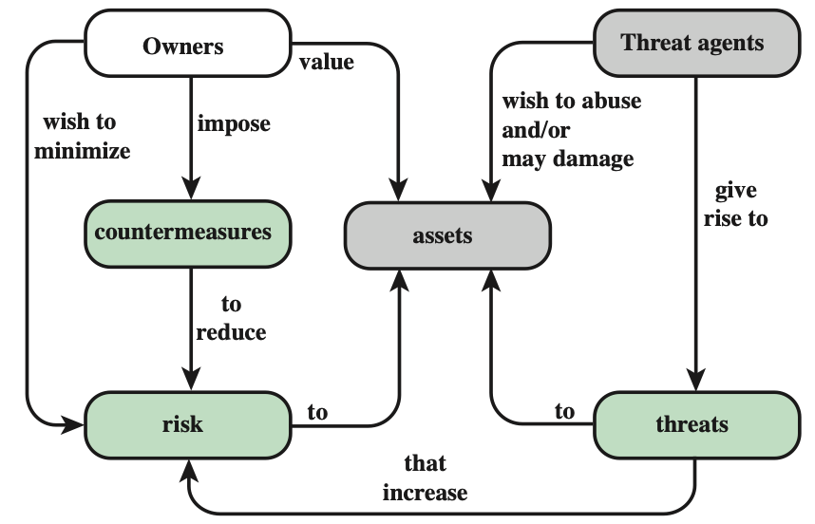
Security Concepts and Relationships (from RFC 2828, Internet Security Glossary)

Slide 26
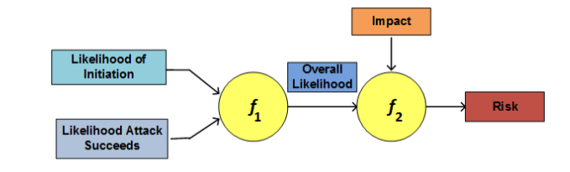
Security Concepts and Relationships (from RFC 2828, Internet Security Glossary)
Adversary (threat agent)
Individual, group, organization, or government that conducts or has the intent to conduct detrimental activities
Attack
Any kind of malicious activity that attempts to collect, disrupt, deny, degrade, or destroy information system resources or the information itself
Countermeasure
A device or techniques that has as its objective the impairment of the operational effectiveness of undesirable or adversarial activity
Aims to prevent espionage, sabotage, theft, or unauthorized access to or use of sensitive information or information systems
Risk
A measure of the extent to which an entity is threatened by a potential circumstance or event, and typically a function of: (i) the adverse impacts that would arise if the circumstance or event occurs; and (ii) the likelihood of occurrence

Slide 27
Security Concepts and Relationships (2) (from RFC 2828, Internet Security Glossary)
Security Policy
A set of criteria for the provision of security services; It defines and constrains the activities of a data processing facility in order to maintain a condition of security for systems and data.
System Resource (Asset – Hardware, Software, Data, Network)
A major application, general support system, high impact program, physical plant, mission critical system, personnel, equipment, or a logically related group of systems
Threat
Any circumstance or event with the potential to adversely impact/harm: organizational operations (including mission, functions, image, or reputation), organizational assets, individuals, other organizations, or the Nation through an information system – via unauthorized access, destruction, disclosure, modification of information, and/or denial of service
Vulnerability
Flaw or weakness within: an information system, system security procedures, internal controls, or implementation that could be exploited or triggered by a threat source
Basically, a threat is a possible danger that might exploit a vulnerability…

Slide 28
Vulnerabilities, Threats and Attacks
Categories of vulnerabilities
Corrupted (loss of integrity)
Leaky (loss of confidentiality)
Unavailable or very slow (loss of availability)
Threats
Capable of exploiting vulnerabilities
Represent potential security harm to an asset
Attacks (threats carried out)
Passive – attempt to learn or make use of information from the system that does not affect system resources
Active – attempt to alter system resources or affect their operation
Insider – initiated by an entity inside the security parameter
Outsider – initiated from outside the perimeter

Slide 29
Levels of Impact
Low
The loss could be expected to have a limited adverse effect on organizational operations, organizational assets, or individuals
Moderate
The loss could be expected to have a serious adverse effect on organizational operations, organizational assets, or individuals
High
The loss could be expected to have a severe or catastrophic adverse effect on organizational operations, organizational assets, or individuals
(i) organization functions are noticeably reduced; (ii) minor damage to assets; (iii) minor financial loss; or (iv) minor harm to individuals
(i) organization functions are significantly reduced; (ii) significant assets damage; (iii) significant financial loss; or (iv) significant but not life-threatening individuals harm
(i) organization functions are severely disrupted; (ii) major damage to assets; (iii) catastrophic financial loss; or (iv) individual loss of life or life-threatening injuries

Slide 30
Some Survey Findings…
The chief impediment to implementing cloud services was security, listed by 85% of federal IT managers
Source: MeriTalk Cloud Computing Exchange
67% of IT professionals say their organization is very vulnerable because cloud ports and firewalls are not adequately secured
Source: Ponemon Institute
“…human factors, is the biggest contributor responsible for 50 to 80 percent of network device outages”
Source: Juniper Networks Whitepaper

Slide 31
In-Class Exercise: How to Secure Linux OS?
To avoid malicious compromise of system resources, following issues need to be addressed:
Use strong passwords – lock account if multiple login failures
Install only the required software packages
Do you need Apache?
Setup access lists for services (i.e., host firewall)
Regularly patch the OS
Check listening ports and verify if those are required
Use “netstat” or even an Intrusion Detection System (IDS) for monitoring
Run only required system services
Use “chkconfig” to list all services started at bootup
Avoid telnet, rlogin and rsh – use scp/sftp instead
Secure remote access
Secure NFS if sharing files over network
For more details - http://www.puschitz.com/SecuringLinux.shtml

Slide 32
Online Security Resources
CERT
www.cert.org
Microsoft Security Response Center
https://www.microsoft.com/en-us/msrc?rtc=1
F-Secure
www.f-secure.com
SANS
www.sans.org

Slide 33
Certification List
(5%) Certificate of Cloud Security Knowledge (CCSK) https://cloudsecurityalliance.org/education/ccsk/
(10%) ISC2 Certified Cloud Security Professional (CCSP) https://www.isc2.org/certifications/ccsp
(5%) ISC2 Certified in Cybersecurity (CC) https://www.isc2.org/certifications/cc
(10%) ISC2 Systems Security Certified Practitioner (SSCP) https://www.isc2.org/certifications/sscp
(10%) CompTIA Security+ https://www.comptia.org/certifications/security

Slide 34
Network, IoT, and Cybersecurity Lab
(EagleCyberNest @ HE 303)
Is Hiring!!!
Visit: chengyiqu.com → EagleCyberNest

Slide 35
Network, IoT, and Cybersecurity Research Lab
We’re the 1st student research lab focus on network and cybersecurity in the computing and software engineering department!!!
This research job counts for FGCU service-learning hours!
We have tons of network devices and resources (e.g., routers, switches, racks, high-speed network)!!!
We even have drones!
Come and join us! Email your resume now! cqu@fgcu.edu

